Slide 1

Detecting and Mitigating AI Misuse Risk
A Proactive Trust & Safety Analytics Framework
Simulating a proactive analytics approach to AI safety risk management
Marcus Gillis
Data Analytics Portfolio Project
Tools: SQL • Excel • Tableau

Slide 2
The Challenge
• Generative AI introduces scalable and evolving misuse risks
• Traditional detection systems are primarily reactive
• Risk patterns evolve faster than static policy frameworks

Slide 3
Objective
• Identify patterns of AI misuse
• Measure operational risk and detection performance
• Propose strategies to reduce harmful activity

Slide 4
Approach
• Synthetic dataset simulating AI misuse behavior
• SQL-based metrics framework for risk measurement
• Tableau dashboard for real-time monitoring and decision support

Slide 5
Key Findings
• 40% of violations fall into the “other” category, indicating a lack of classification granularity
• 45% of violations originate from repeat offenders, suggesting concentrated user-level risk
• Average detection time of 3.37 hours reveals a meaningful exposure window
• A 6% abuse rate represents significant risk at scale

Slide 6
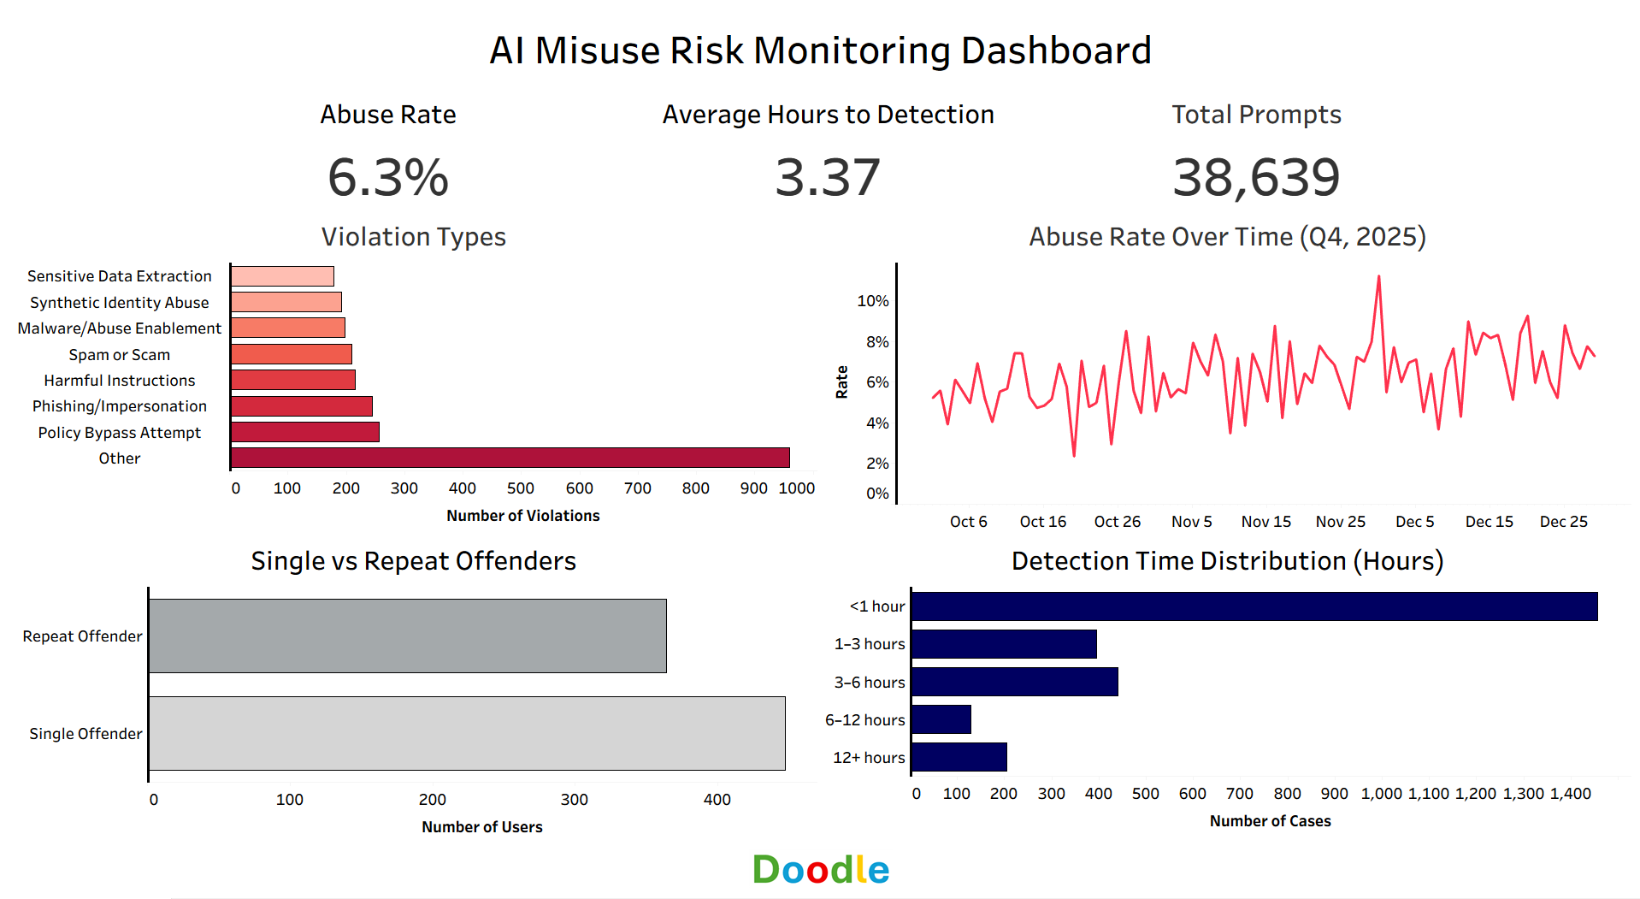
Monitoring AI Misuse Risk

Slide 7
Recommendations
• Improve classification granularity to better capture emerging threats
• Prioritize high-risk users through behavior-based monitoring
• Reduce detection latency through real-time risk scoring
• Focus interventions on high-impact segments

Slide 8
Expected Impact
• Faster detection of harmful activity
• Reduced exposure to policy-violating content
• More efficient allocation of Trust and Safety resources
• Improved long-term platform safety and resilience

